Slide 1

Machine Learning Is Learning Feasible?
Prof.Shuyuan Yang, Zhixi Feng
E-mail： syyang@xidianedu.cn
zxfeng@xidian.edu.cn

Slide 2
Contents
Supervised-learning -- Generative VS. Generative Learning
What constitutes a learning problem?
Is learning feasible?
Is learning feasible?

Slide 3
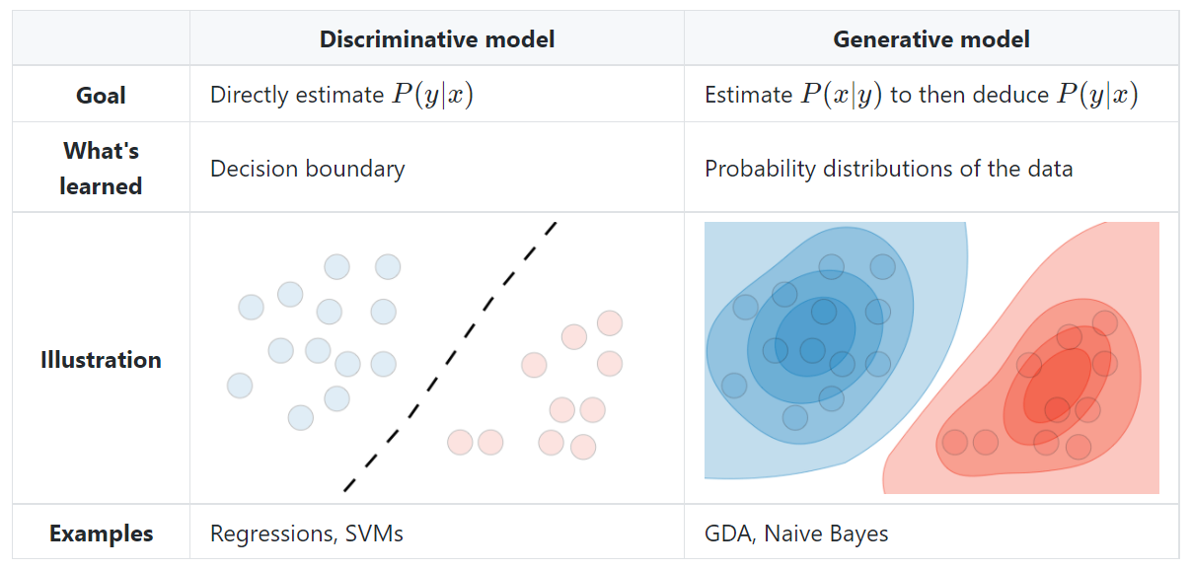
Type of model

Slide 4
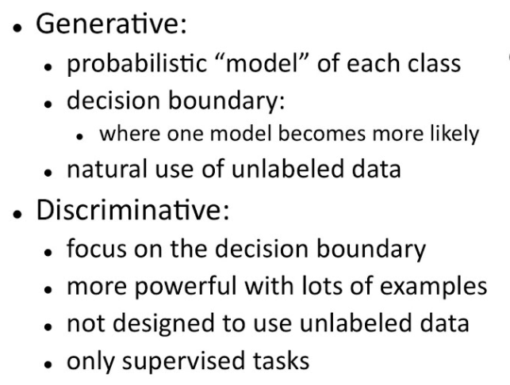
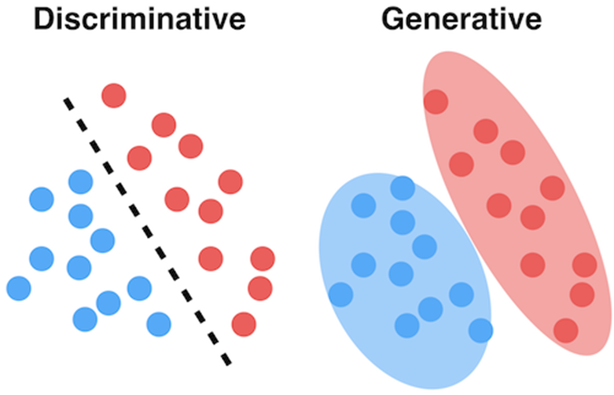
Generative VS. Generative Learning

Slide 5
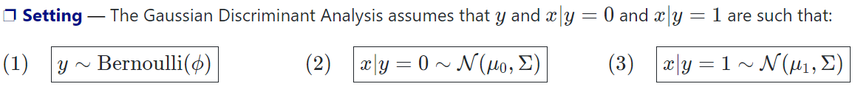
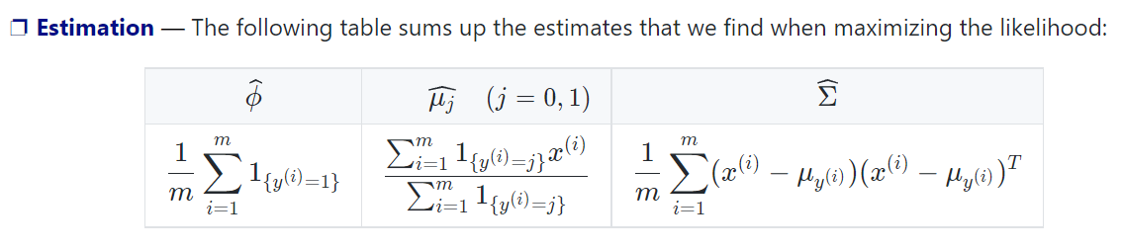
Gaussian Discriminant Analysis

Slide 6
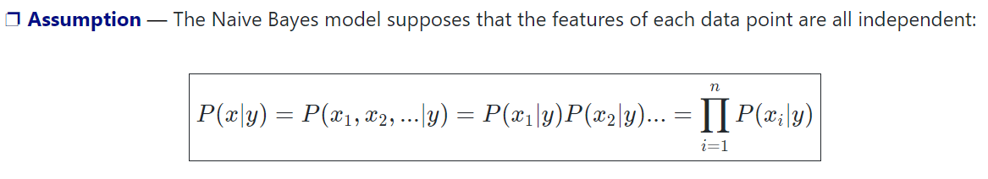
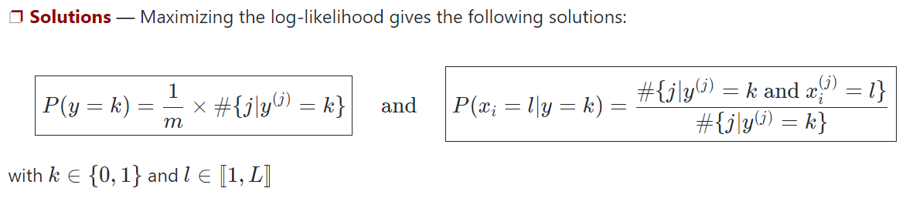
Naive Bayes
Remark: Naive Bayes is widely used for text classification and spam detection.

Slide 7
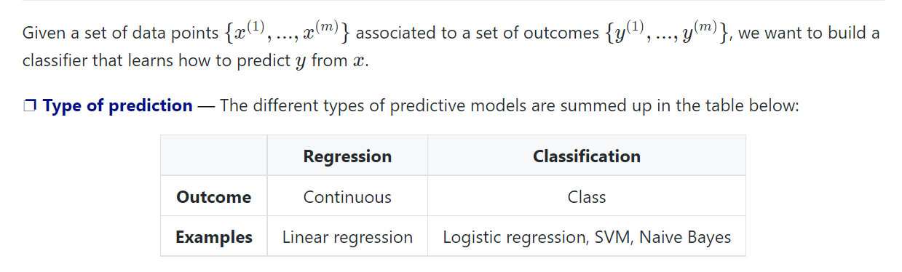
Supervised Learning cheatsheet

Slide 8
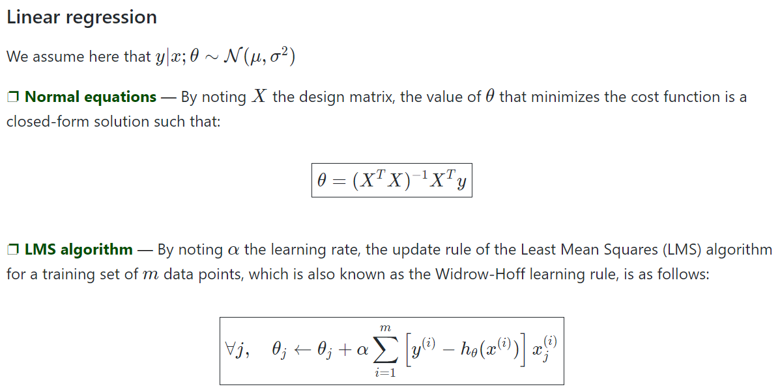
Supervised Learning
Remark: the update rule is a particular case of the gradient ascent.
Remark: Stochastic gradient descent (SGD) is updating the parameter based on each training example, and batch gradient descent is on a batch of training examples.

Slide 9
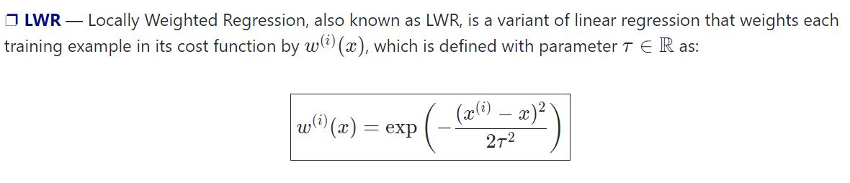
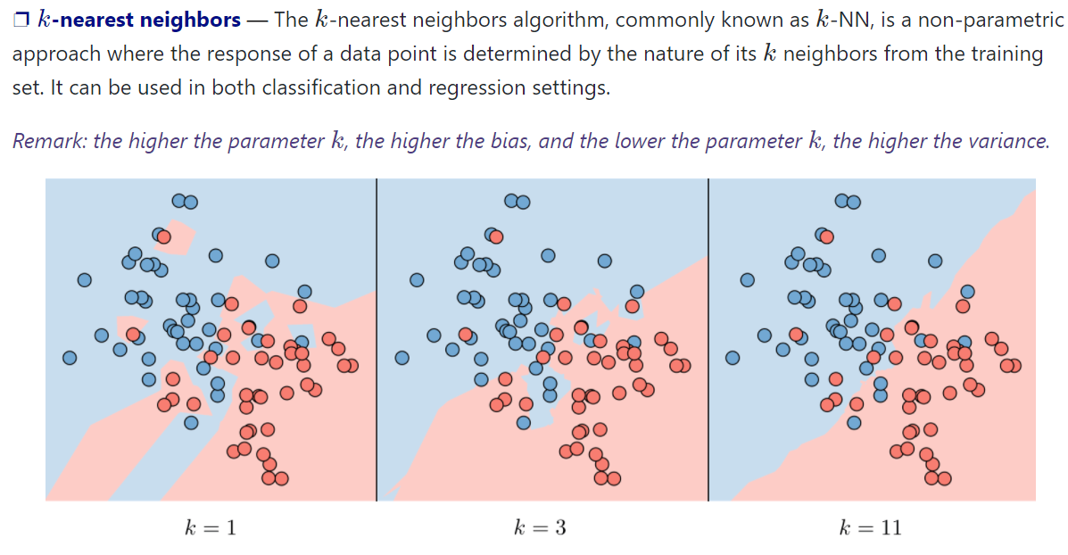
Supervised Learning
regression settings.
Non-parametric approaches

Slide 10
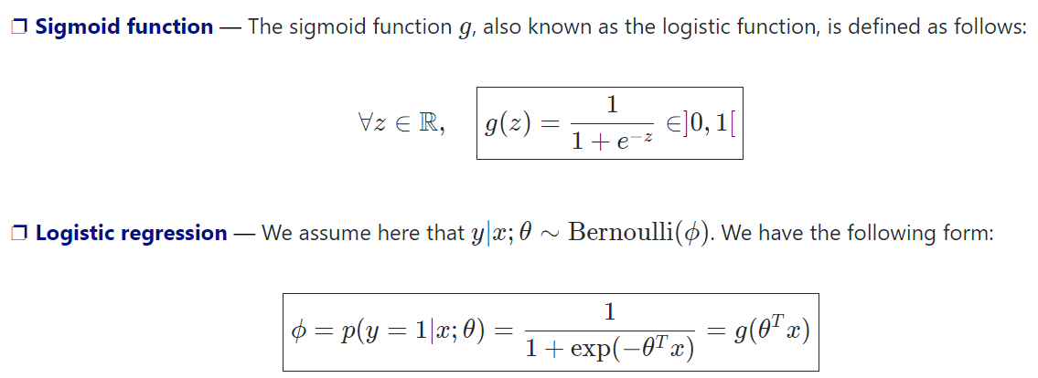
Classification and logistic regression
Remark: logistic regressions do not have closed form solutions.
Remark: logistic regressions do not have closed form solutions.

Slide 11
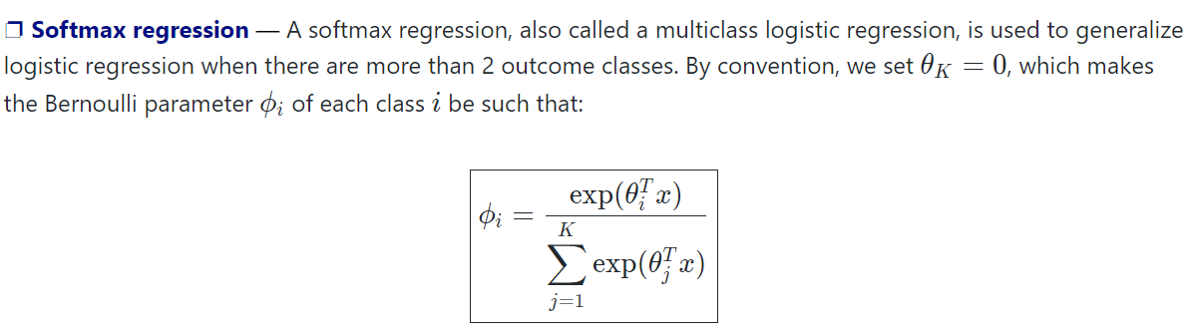
Classification and logistic regression

Slide 12
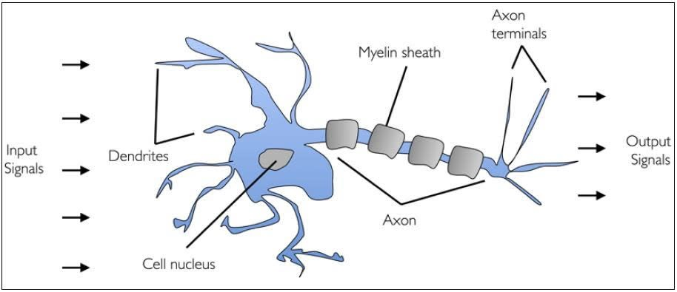
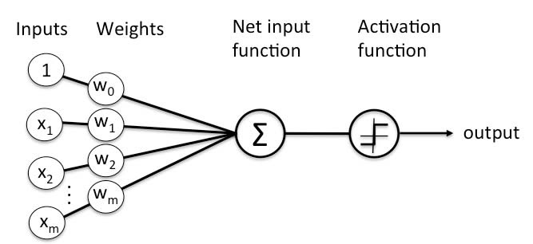
Classification and logistic regression
Perceptrons: Single layer and Multilayer.
Single layer - Single layer perceptrons can learn only linearly separable patterns
Multilayer - Multilayer perceptrons or feedforward neural networks with two or more layers have the greater processing power
Perceptron Learning Rule/ Algorithm
Pockets Algorithm
Convergence of PLA
Linearly fractionable data set

Slide 13
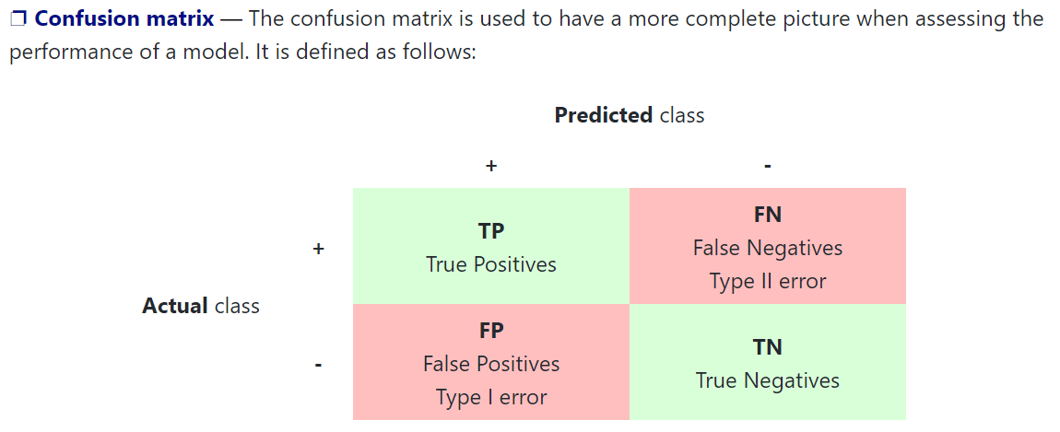
Classification metrics

Slide 14
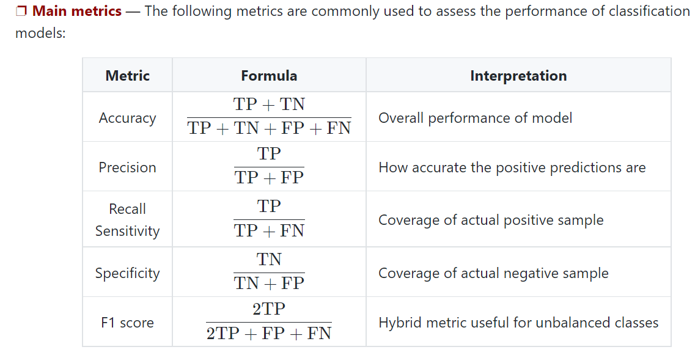
Classification metrics

Slide 15
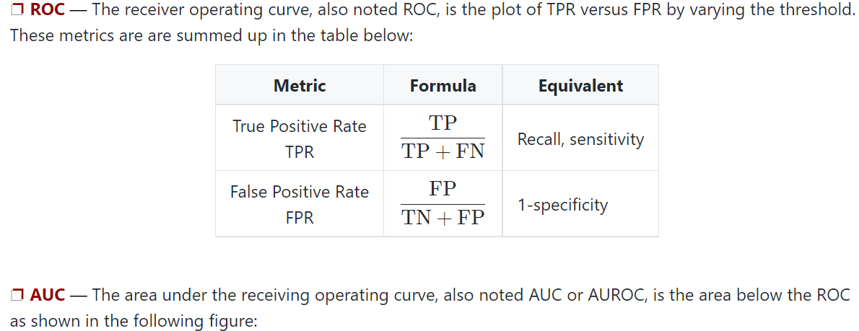
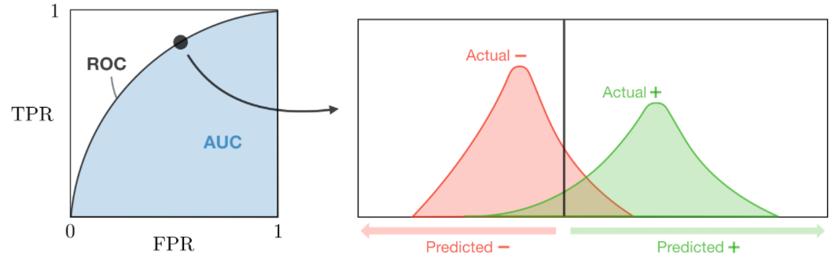
Classification metrics

Slide 16
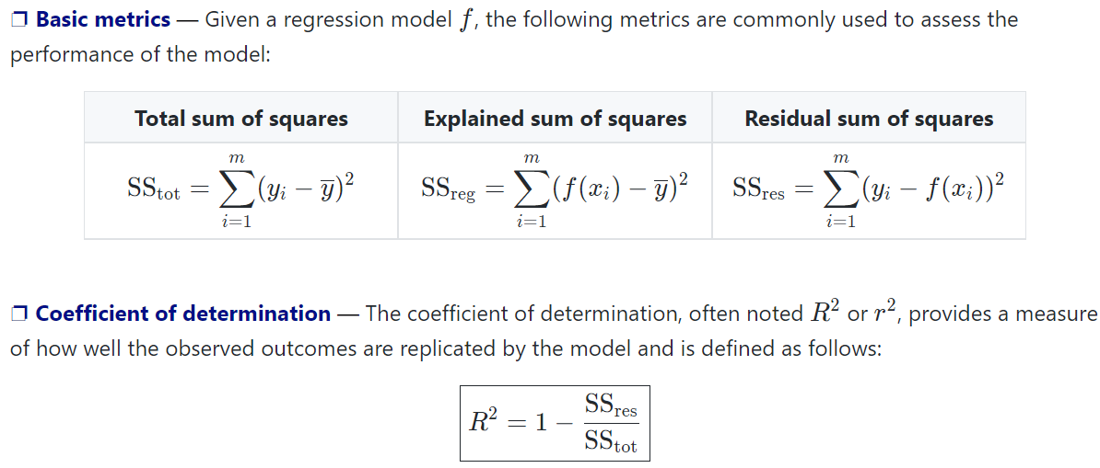
Regression metrics

Slide 17
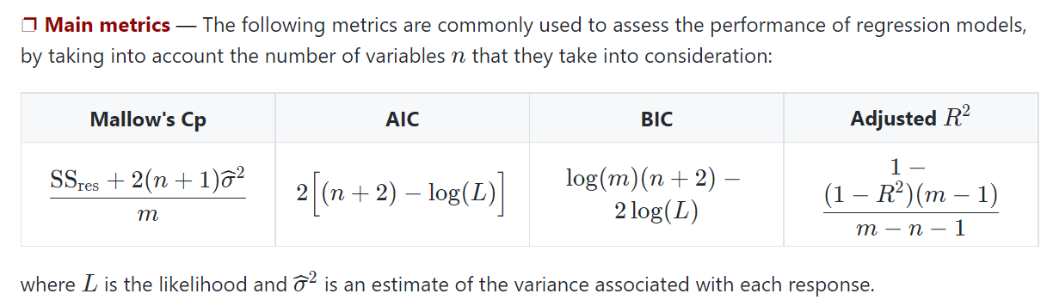
Classification metrics

Slide 18
Contents
Generative VS. Generative Learning
What constitutes a learning problem?
Is learning feasible?
Is learning feasible?

Slide 19
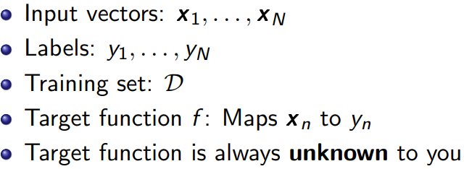
Dataset
Dataset

Slide 20
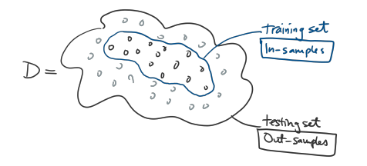
Training and Testing Set
Training and Testing Set
In-sample: Samples that are inside the training set
Out-sample: Samples that are outside the training set

Slide 21
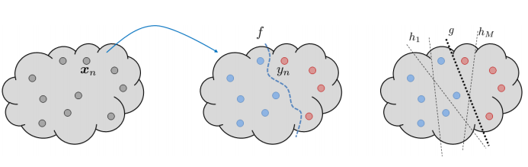
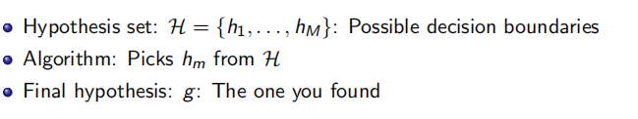
HypothesisFucntion

Slide 22
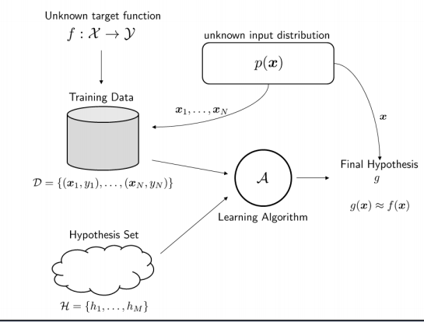
Learning Model

Slide 23
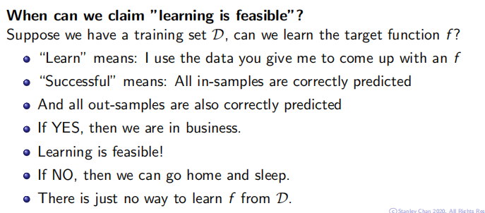
Is Learning Feasible?
In-sample and Out-sample:
In-sample: Training Data
Out-sample: Testing Data

Slide 24
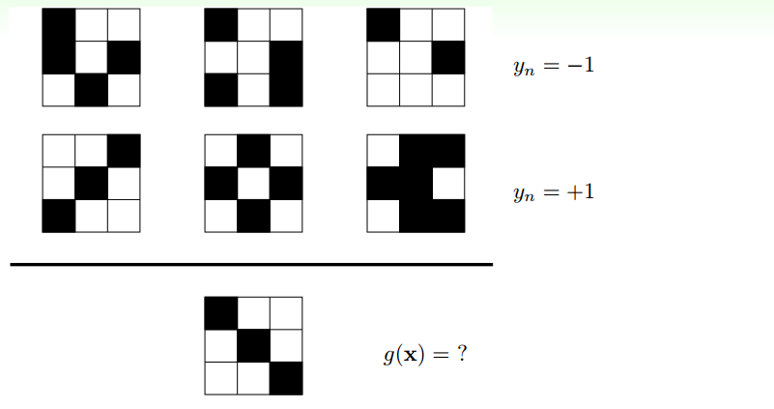
Is Learning Feasible?

Slide 25
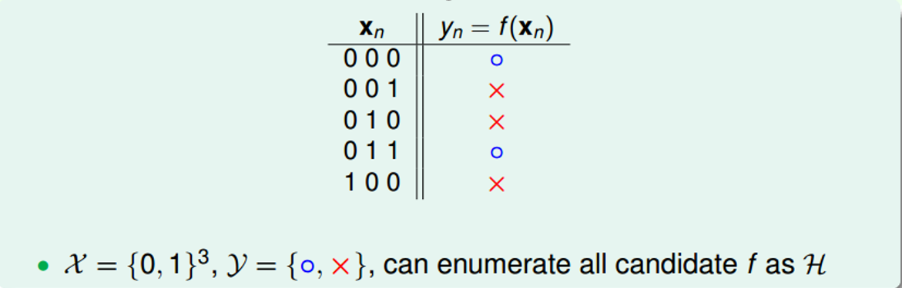
A ‘Simple’ Binary Classification Problem
How many possible vectors are there?
How many possible f’s ?

Slide 26
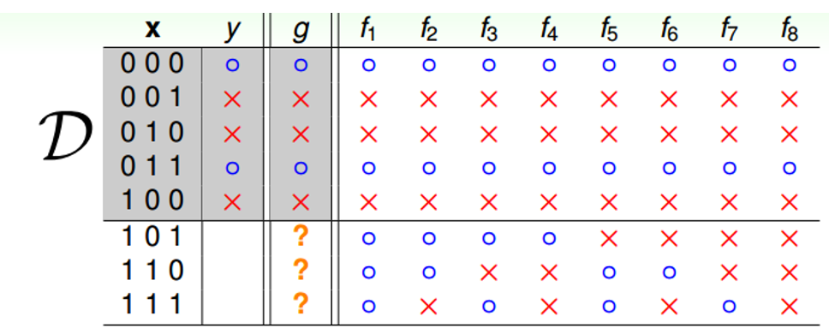
A ‘Simple’ Binary Classification Problem
We have 8 input vectors:
We have 256 hypotheses:
Is learning feasible?

Slide 27


A ‘Simple’ Binary Classification Problem

Slide 28
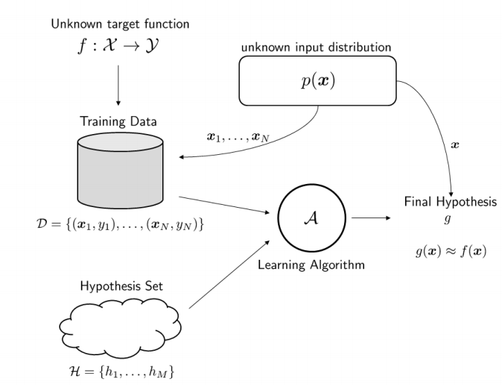
The Power of Probability

Slide 29
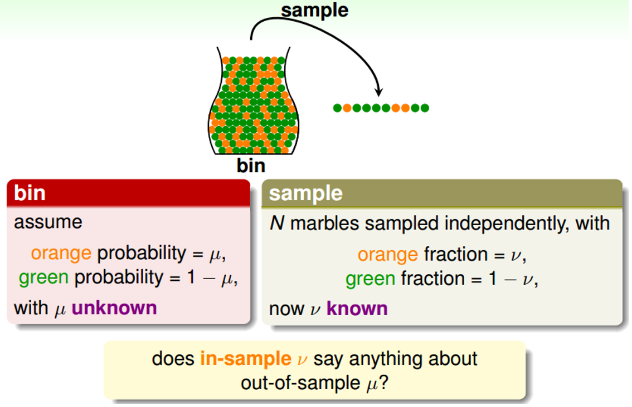
The Power of Probability

Slide 30
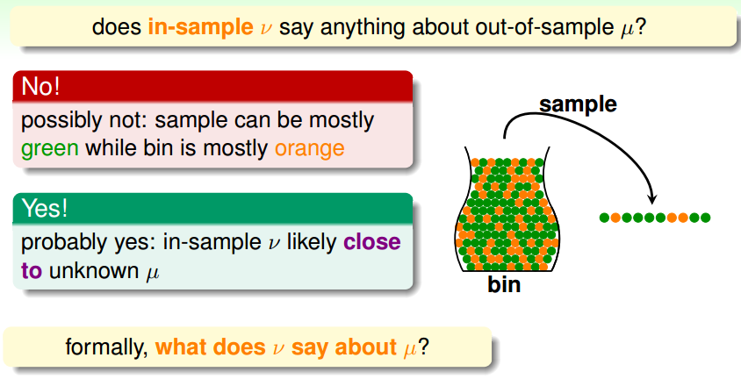
The Power of Probability

Slide 31
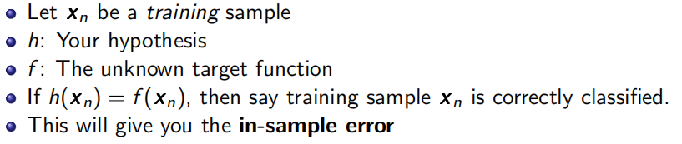
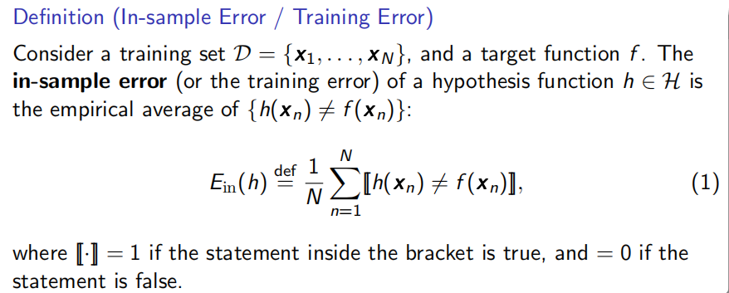
In-Sample Error

Slide 32
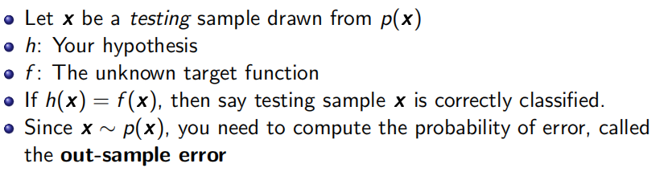
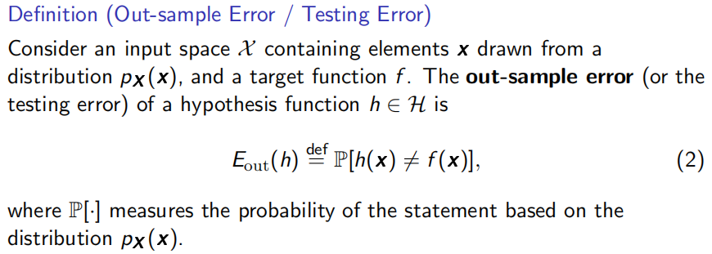
In-Sample Error

Slide 33
Out-Sample Error

Slide 34
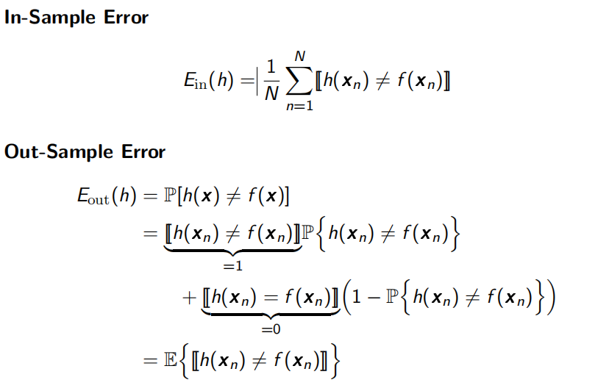
In-sample VS Out-sample

Slide 35
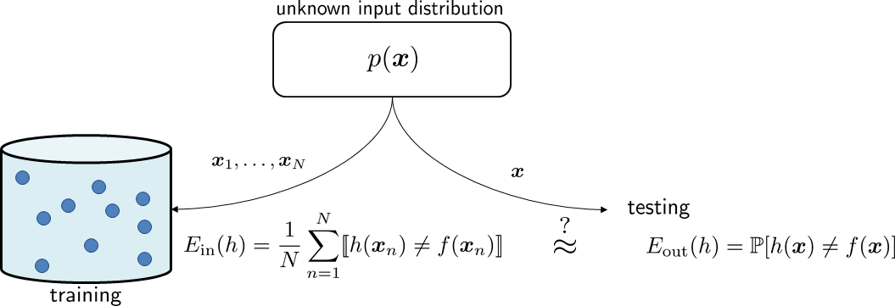
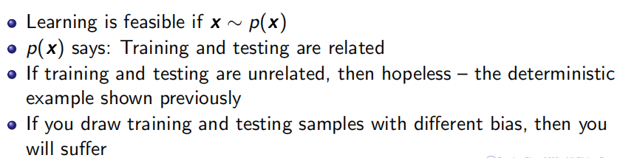
The Role of p(x)

Slide 36
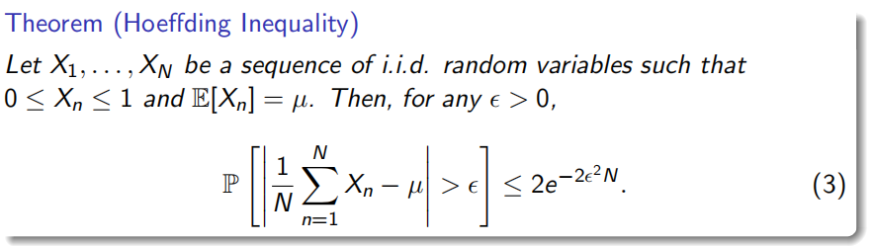
Theorem (Hoeffding Inequality)
Notes:
在概率论中，霍夫丁不等式给出了随机变量的和与其期望值偏差的概率上限

Slide 37
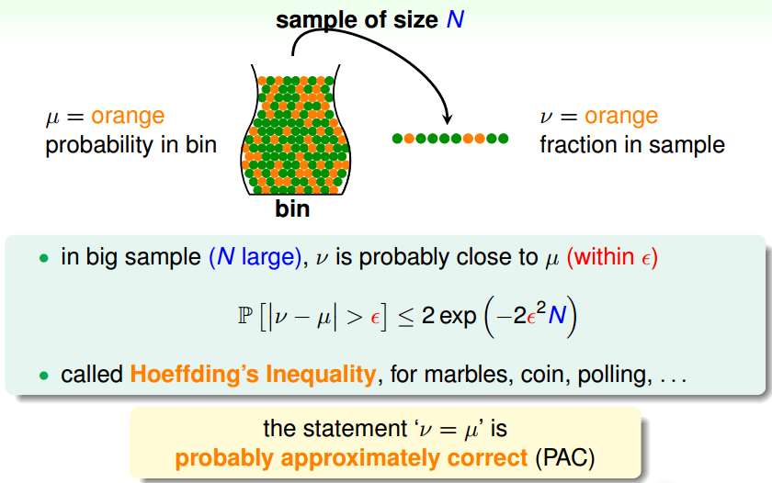
When Will Ein = Eout?

Slide 38
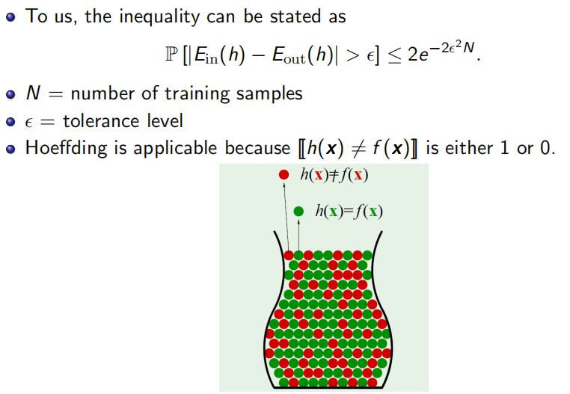
When Will Ein = Eout?

Slide 39
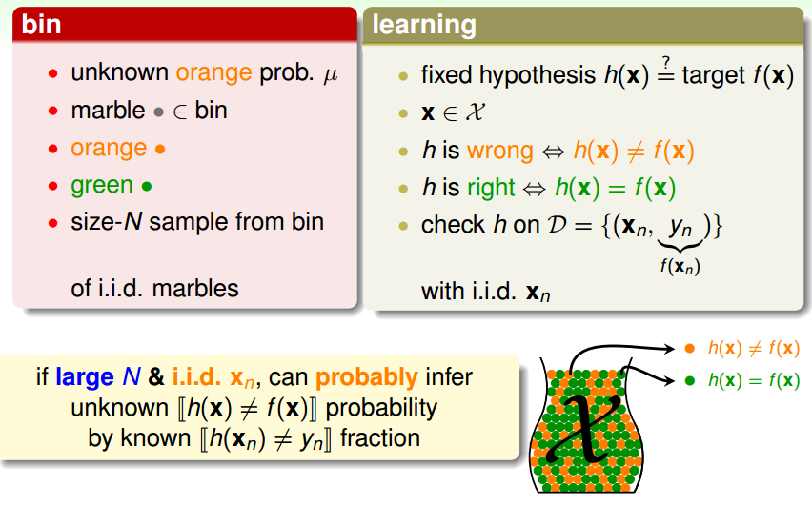
Connection to Learning

Slide 40
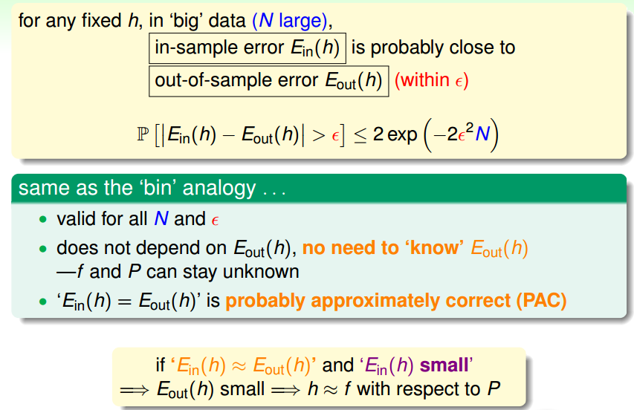
The Formal Guarantee

Slide 41
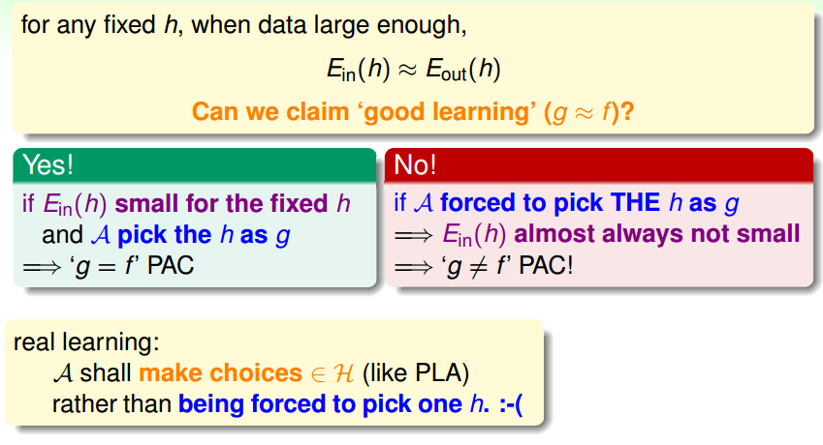
Verification of One h

